Slide 1
FairTSA Value Proposition
The Fair-Trade Sustainability Alliance is rooted in a strong program with well-defined requirements. We engage with all partners in the supply chain.
We are dedicated to finding solutions for your unique situation. We stand for accountability and affordable solutions.
We are supportive and appreciative of all our partners – producer organizations, licensee partners, and certification agencies.
We are there for our partners when they need us!

Slide 2
We believe in:
Meaningful Community Impact
Clear Standard
with well- defined exclusion criteria
Affordability for
all Partners

Slide 3
Flexibility and
True Collaboration
Efficient and Affordable
Certification
Project-based
Accountability
Measurable
Local Impact

Slide 4
Flexibility & True Collaboration means:
Community development and Compliance support for all partners
Cultural sensitivity and flexible cooperation
Free pre-certification and monthly producer
Webinars in English
and Spanish
Flexible criteria for non-
traditional Community
Development Projects
Equivalency with
other Fair Trade programs

Slide 5
Efficient & affordable certification means:
We strive to provide lowest certification cost in the marketplace
Full acceptance of all ISO 17065 accredited certifiers
No exclusivity for certain certification agencies
Integrated Organic & Fair Trade Inspections resulting in reduced logistics & carbon footprint

Slide 6
Project-based Accountability means:
Financial Accountability by communicating premium amounts and usage throughout the supply chain
Annual Community Development project
Documentation & approval
Collaboration with Producer communities to identify impactful & sustainable projects
Full transparency including distribution of reports and website posting

Slide 7
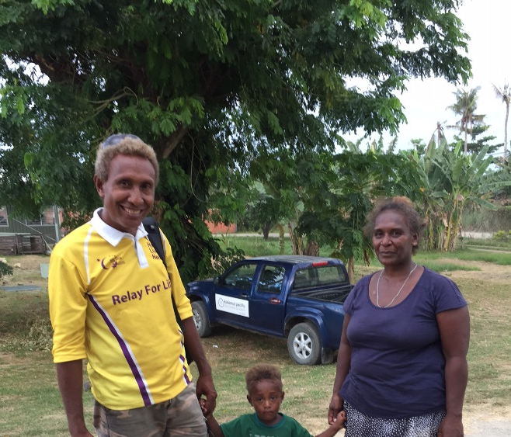
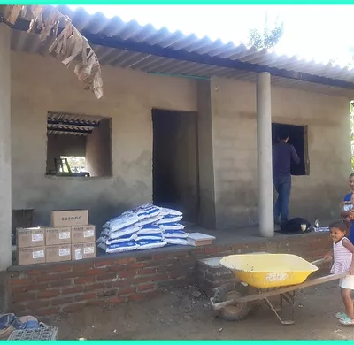
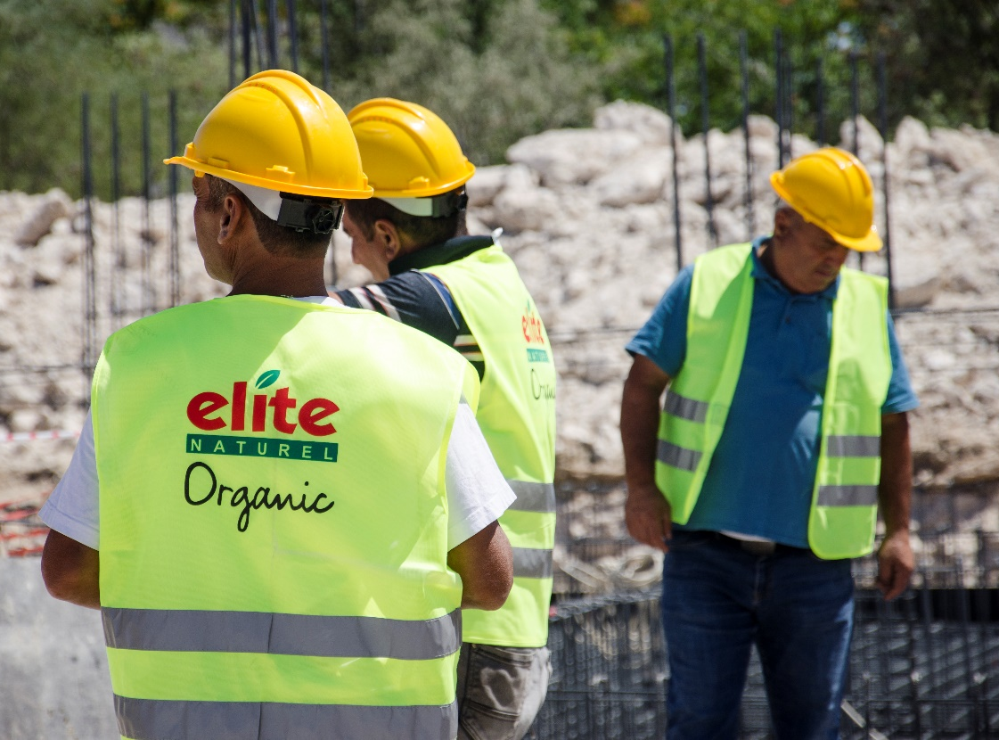
Measurable Local impact means:
Constructing of houses for workers in Columbia
Creating jobs for small farmers on the Solomon Islands
Building the foundation
for a school in Eastern Turkey

Slide 8
What our Partners say:
“FairTSA offers an innovative way to develop Fair Trade. The specificity of the FairTSA label is its proximity to the supply chain, its flexibility, and its reduced management costs. […] Thanks to Its reduced management cost the money goes to the producers and is not lost in administration fees.” Joaquin Moreno, Bonabio SAS, France
“Being certified according to the FTSA standard enabled us to work together with the farmers on projects spanning a longer period and lasting impact. We very much appreciated the accessibility of the people behind FTSA and their practical approach and solutions.” Arjon Kalter, Managing Director, Good Food Foundation, The Netherlands/Turkey

