Slide 1

FairTSA
The Fair Trade Sustainability Alliance
Community Development:
Project-Based Accountability ​& Engagement with Rural Communities

Slide 2

Our Philosophy
FairTSA believes in Engagement with rural communities through Empowerment, Inclusivity, and Opportunity​
Creating opportunities by way of Appreciation of small farmers’ work is materialized in the Social Premium​
Encouraging self-confidence through Joint Decision-making and Project-planning and improving living conditions for rural communities, farmers, and processors through
Maintaining Trust through Accountability documenting Impacts

Slide 3

Complimentary & Continued Support​
FairTSA provides Support even before an operation decides join our program by way of…
Regular Free Producer Webinars in English and Spanish, French and Arabic on demand​, including individual introductions to Compliance Requirements and the FairTSA System Plan
Individual Discussion of possible Marketing & Sales & Community Development Project opportunities​
No consultants necessary to join the program

Slide 4
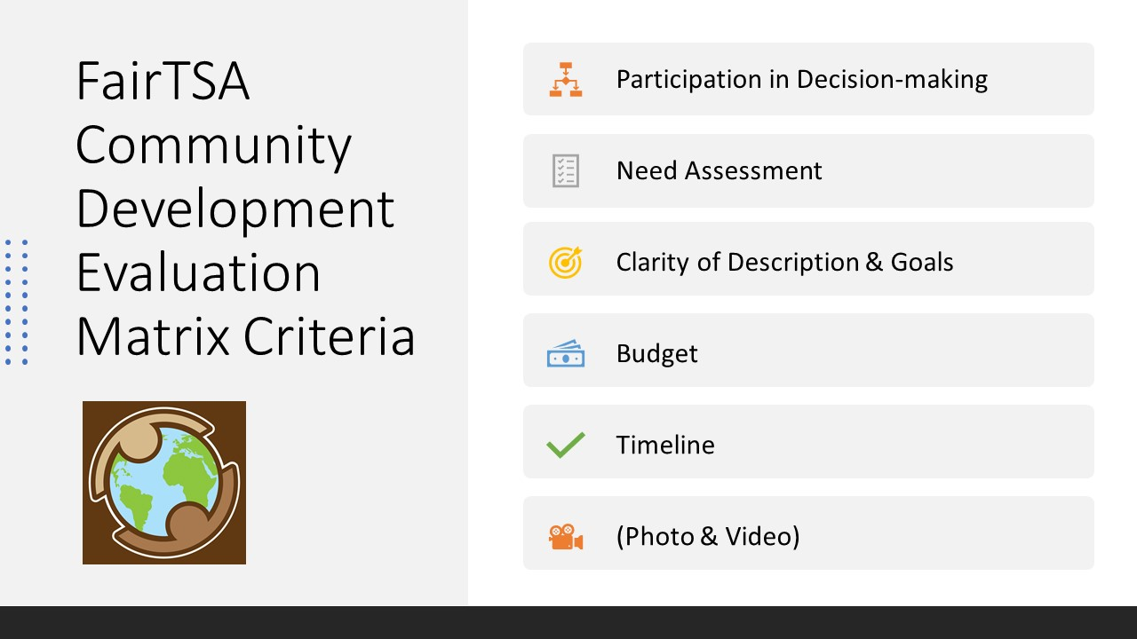
FairTSA Project Evaluation Criteria

Slide 5
Admissible Projects per the FairTSA Standard
Improving or Restoring the Natural Environment
Minimizing Greenhouse Gas Emission and Efficient Energy Use Projects
Water Security
Waste and Wastewater Treatment
- Health Care Projects
Food Security Projects
- Educational Projects
Agricultural Production and Post-Harvest Treatment (APPHAT) Projects
- Improving Workers’ Living Conditions
- Small Business and Vocational Training
- Cultural Projects
Other Admissible CDP:
Other projects with potentially significant positive impact on the producer community will be considered for approval

Slide 6
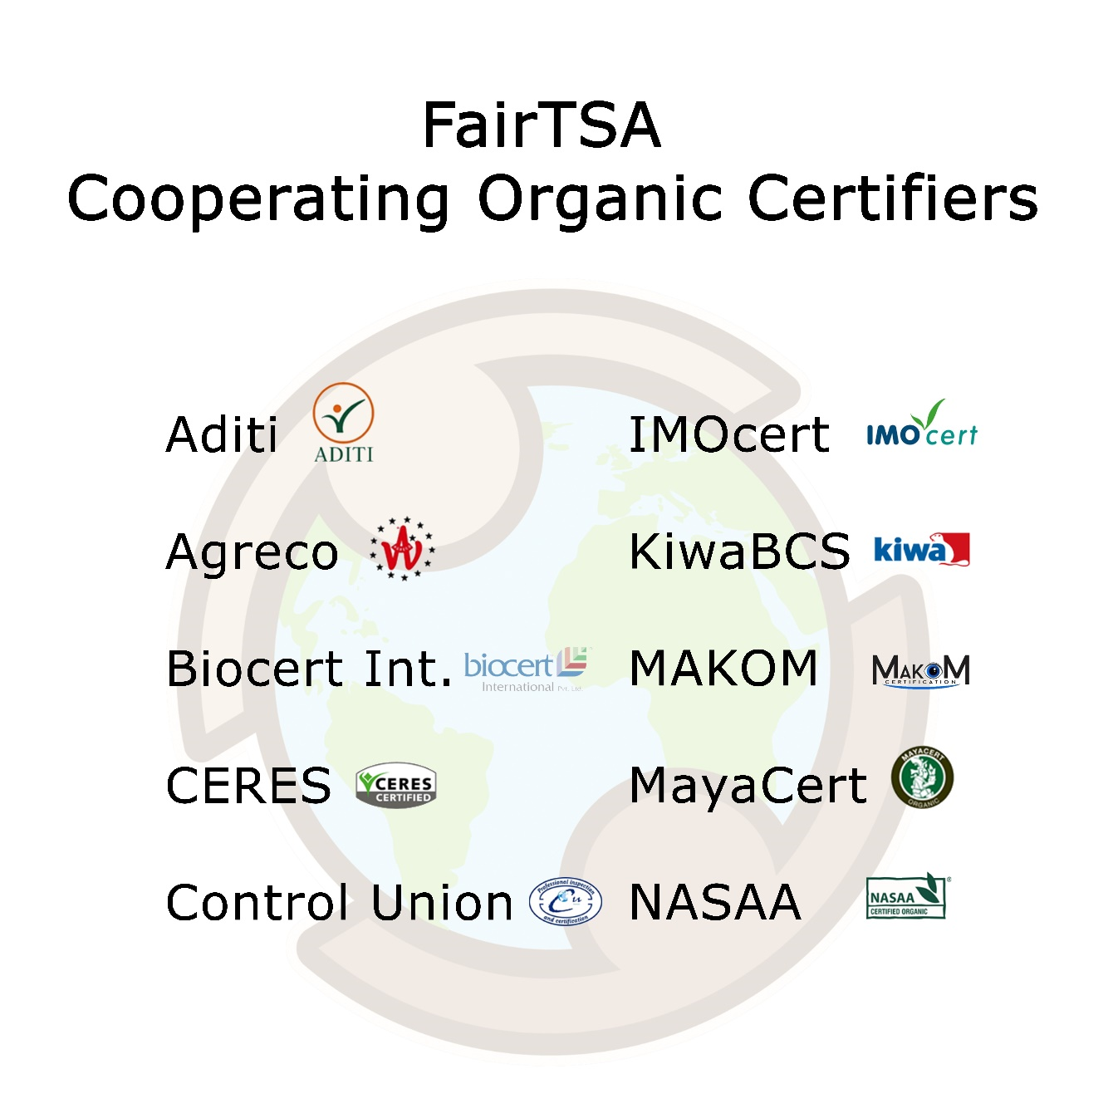

Slide 7

2023-4 Community Development Highlights
Farmer education programming in Cambodia
Constructing worker facilities in Mexico
Potable water and food security in Egypt
Solar panels & lights, healthcare programs, natural disaster aid in the Philippines
School constructions in India and Turkey
Worker housing in Colombia
Education scholarships and worker transportation in the Dominican Republic

Slide 8
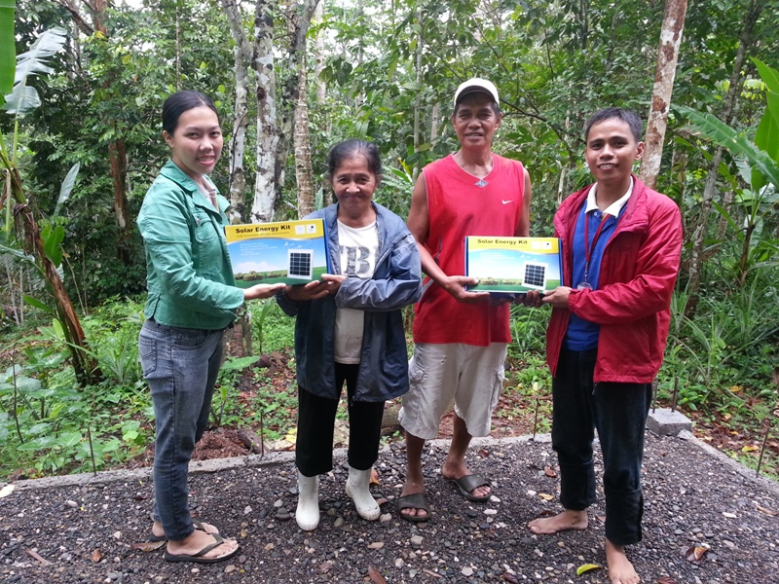

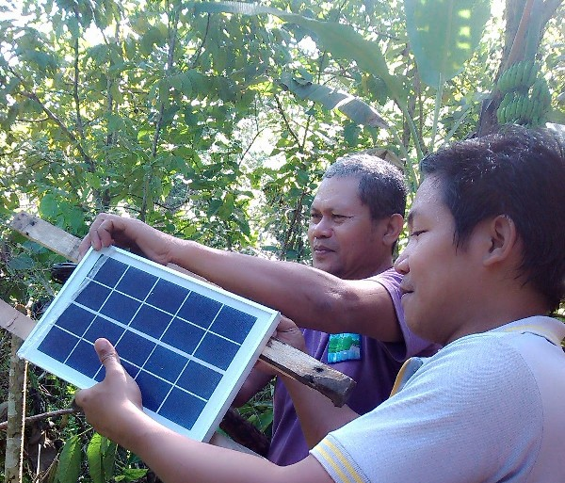
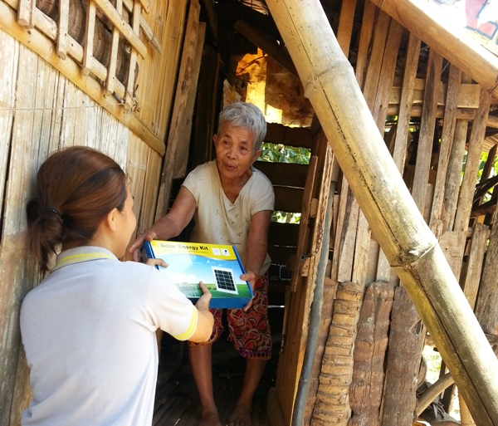
CELEBES, Philippines
CDP 2014: Solar Lights
For many remotely-located villagers working with Celebes, cell phone communication is the only way to coordinate for the collection of their coconuts- an often-complicated process involving the maneuvering of large trucks across extreme terrain. Despite this necessity, many villagers lack access to electricity and must travel more than an hour to charge their devices, which are thus only charged for one or two days a week. In order to address this dilemma farmer members decided to install solar panels in villager homes to provide basic lighting and allow for the charging of phones. This also increases community safety and provides light after dark for a better quality of life.

Slide 9
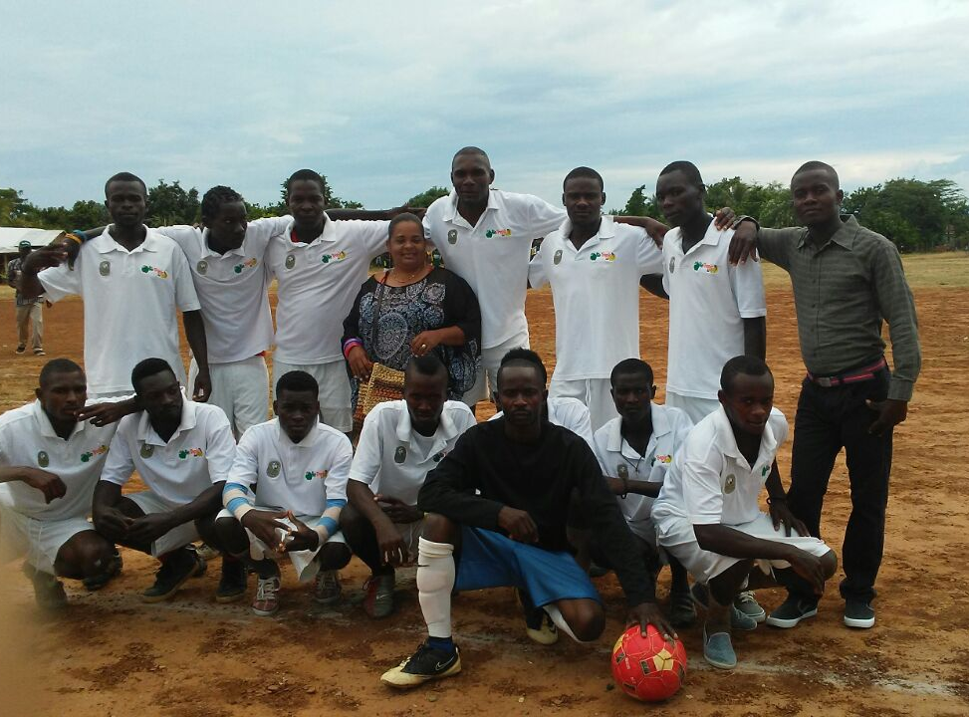
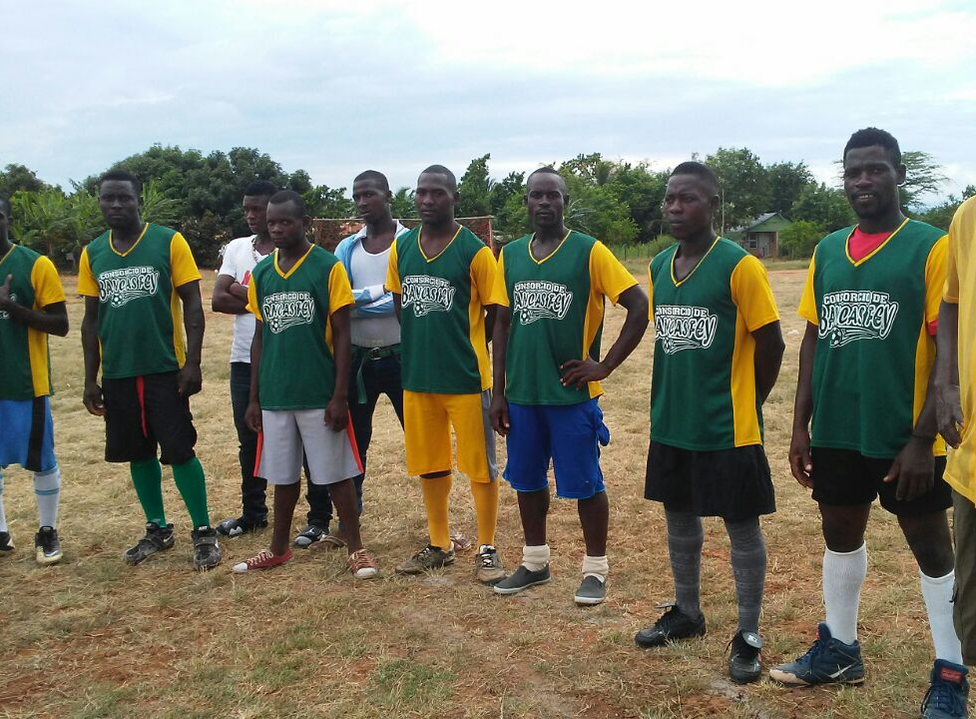
BioTropic, Dominican Republic
CDP 2017: Natural Disaster Relief
In 2017, a series of tropical storms severely damaged crops and infrastructure in the DR, forcing Finca de la Lobo to split into two separate villages. Following this disaster, producers have divided premium funds between the two villages, with post hurricane projects supporting producer morale and survival as they rebuild their community. Projects included a worker compensation fund to alleviate wages lost to flooded crops. Replanting of banana trees was a big effort, as well as the installation of improved irrigation system in defense of future natural disasters. There was also the planning of a community event and an inter-village soccer league, with jerseys and gear.

Slide 10
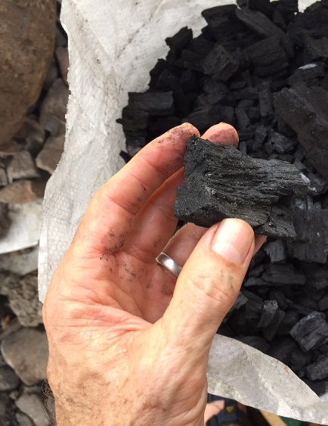
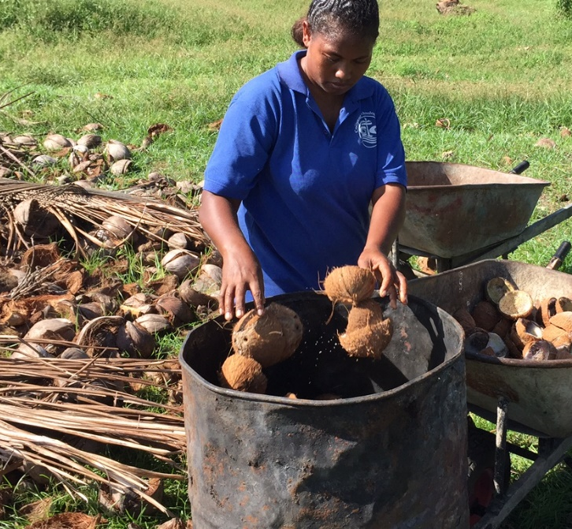
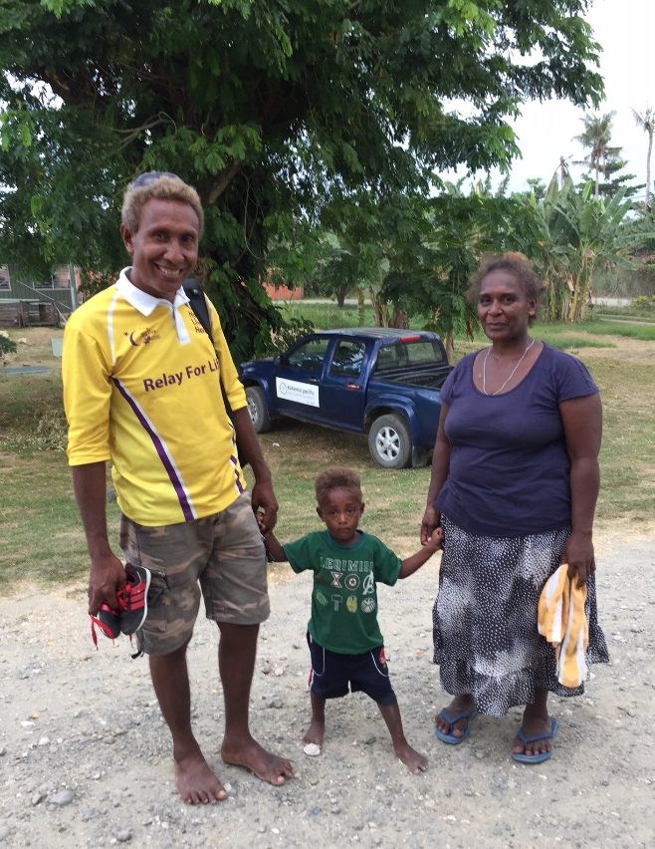
Kokonut Pacific,
Solomon Islands
CDP 2020: Eco crisis into Opportunity
In 2020 there was an unexpected problem threatening the main export of these remote islands. The Coconut Rhinoceros beetles spread all around the oil palm plantations, causing significant risks to the economic security, social cohesion, and political stability. The infected trees were identified and rounded up. In exterminating the bug and destroying the coconut trees, biochar was created from the wood. This created a clean burning fuel to replace older methods which cause chronic health problems with women in the home. In milling lumber and operating kilns, new skills and employment was brought to the community. What’s else is created are building supplies, cost-effective clean fuel for cooking, and fertilizer to enhance local soil productivity and crop yields.

Slide 11
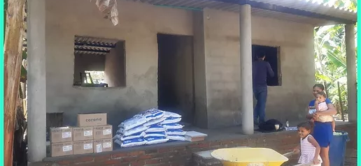
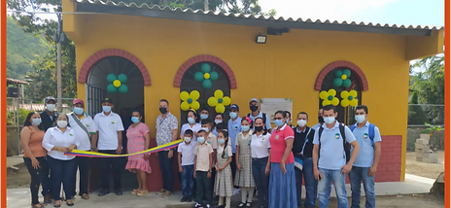
La Samaria, Columbia
CDP 2021: Building Houses and more
La Samaria is a FairTSA Banana producer in Columbia, and they are starting off the first year of their FairTSA Fair Trade Community Development Project with three separate initiatives. This includeded a water purification system for potable water, a housing improvement program, and a classroom construction project. These projects use the FairTSA premium money for direct and effective efforts to improve the daily lives of their workers.

